Slide 1
Title Slide
Title: Source Assessment Writing Project
Name: Mingyue
Course: EAP II: Academic Writing in the U.S.
Professor: Zehala
Date: April 15, 2025

Slide 2
Miss Representation – Primary source
Information:
Directed by Jennifer Siebel Newsom
Released: 2011, Oprah Winfrey Network
Discipline: Gender Studies & Media Studies
A documentary that explores how media underrepresents women and perpetuates stereotypes that limit their roles in society.
Genre & Rhetorical Strategies
Genre: Documentary Film
Ethos: Experts like Condoleezza Rice, Katie Couric
Pathos: Emotional stories from teenage girls
Logos: Stats like % of female media leaders
Juxtaposition: Comparing media portrayal with real-life gender inequality

Slide 3
Main argument from Miss Representation
Media shows women in limited, stereotypical ways
These portrayals affect girls’ self-esteem and life goals
Few women in leadership roles reinforces inequality
Cultural norms discourage female leadership
Change requires diverse representation in media creation

Slide 4
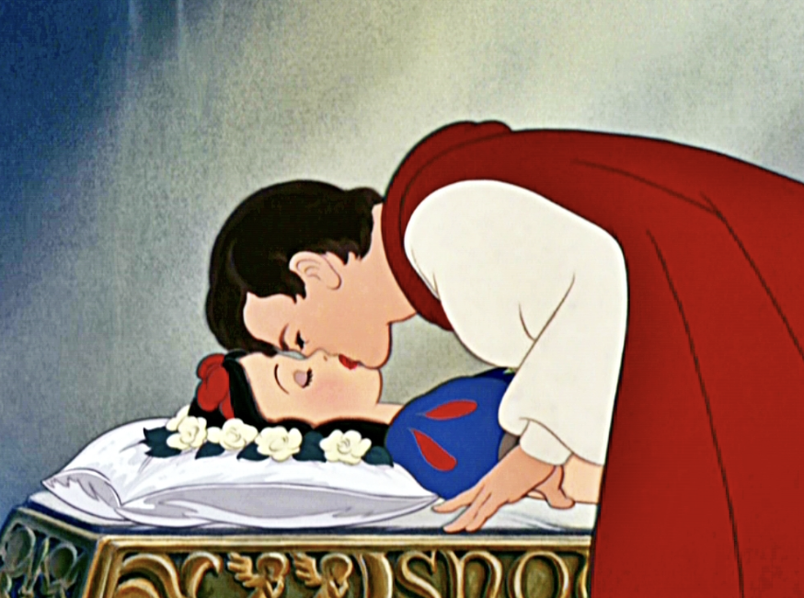
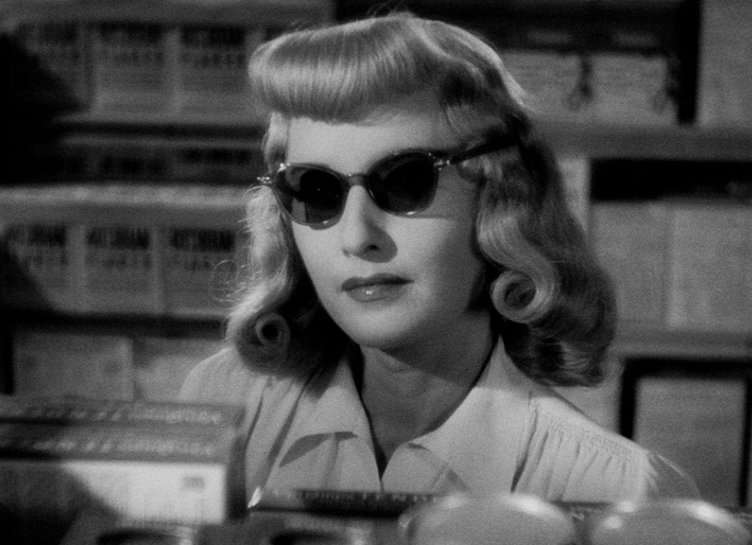
Stereotypes highlighted in Miss Representation
The film Miss Representation directly criticizes the repetitive and narrow portrayals of women in media. Several stereotypes are discussed:
The Damsel in Distress: Helpless, waiting for rescue (e.g., Snow White).
Reinforces passivity and dependence on male characters.
The Femme Fatale: Seductive, manipulative villain (e.g. Double Indemnity).
Suggests that ambitious or independent women are dangerous.

Slide 5
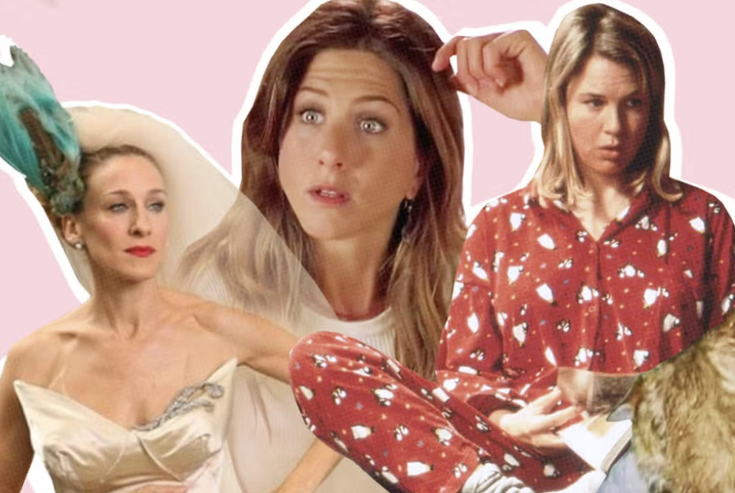
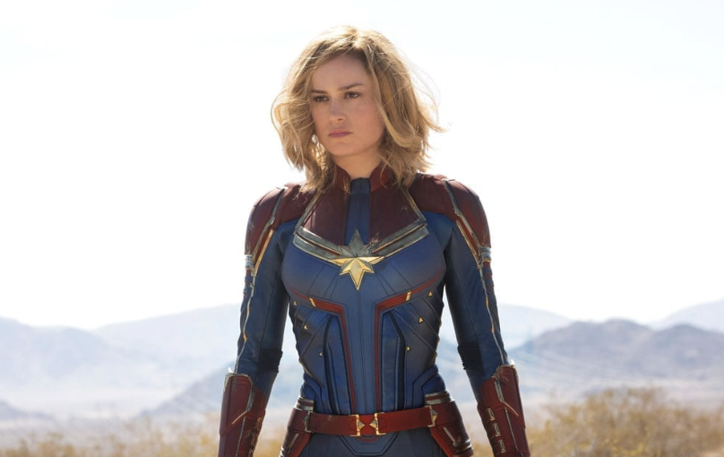
The Strong But Emotionally Cold Woman: Powerful but lacks depth ( e.g. Captain Marvel).
Ignores emotional complexity and human flaws.
The Perfect Wife/Mother: Defined by family duties (e.g. romantic comedies).
Reinforces that a woman’s happiness is tied solely to family life.
The film argues that these tropes limit how young girls imagine their future and keep society stuck in outdated roles.

Slide 6
A Brief history of women in documentary
From the 1920s - 1950s, Hollywood built a formula: women were mostly love interests, mothers, or passive figures. Miss Representation shows old clips to highlight how these roles were repeated until they became the norm.
1960s - 1980s: The feminist movement influenced some films, but even as women gained rights in real life, their roles on screen lagged behind. The film points out that media didn’t keep up with social change.
In the 1990s - 2000s, more female leads appeared, but were still framed by the “male gaze” - valued for their looks, not their ideas. Miss Representation analyzes how even “strong” female characters are sexualized.
The documentary shows that from 2000s to now, women are still drastically underrepresented: “In 2010, women made up only 16% of protagonists in top-grossing films.”
Even when women are on screen, they're often shown in narrow ways. Miss Representation uses fast-paced media montages to prove how persistent these stereotypes are - even in “modern” films.

Slide 7
Roots causes according to Miss Representation
Miss Representation uncovers why these damaging portrayals persist:
Male-Dominated Media Industry: The film shows that most decision-makers in Hollywood are men, which leads to limited female perspectives on screen.
Cultural Conditioning: The documentary includes interviews with teenagers who share how media has taught them to value appearance over intellect.
Profit-Driven Storytelling: Jennifer Siebel Newsom argues that media companies stick to familiar gender roles because “sex sells.”
Lack of Female Leadership: Fewer women behind the scenes means fewer stories that challenge the norm. The film shows how this lack of diversity limits innovation.

Slide 8
The real-world effect: as shown in Miss Representation
Self-Esteem: The film features interviews with teenage girls who talk about feeling pressure to be thin, beautiful, and “perfect.” One says:“I don’t want to be smart. Smart girls aren’t pretty.” This shows how media encourages girls to shrink themselves, physically and mentally.
Career Aspirations: When girls don’t see women in power - like CEOs, politicians, scientists - they’re less likely to imagine themselves in those roles. The film discusses how women like Hillary Clinton and Sarah Palin were often criticized for their clothes or tone of voice more than their policies.
Politics: Newsom points out that media coverage of female leaders is often sexist, undermining their authority. Example: Nancy Pelosi’s leadership was reduced to how she “looks” or “smiles.”
Relationships & Gender Norms: Romantic films often show women’s happiness as depending on men. Miss Representation argues that this trains women to prioritize being desirable over being fulfilled.
Mental Health: The film highlights rising rates of depression and anxiety among teenage girls, linking this partly to media pressure and unrealistic beauty standards.

Slide 9
Signs of Hope mentioned in the document
While Miss Representation focuses on problems, it also highlights growing movements for change:
The film features female journalists, filmmakers, and activists who are pushing back against the stereotypes.
It mentions projects like the Geena Davis Institute on Gender in Media, which collects data and advocates for balance.
Interviewees celebrate films and shows that break traditional molds, like The Hunger Games and Grey's Anatomy.
The documentary itself is part of the solution - by giving voice to underrepresented women, it encourages viewers to demand better media.

Slide 10
Final Refelction
1. Realizing the power of media Miss Representation showed me that media isn’t just entertainment—it influences how we see gender and ourselves. Stereotypes in media aren’t harmless; they shape our thoughts, values, and goals.
2. Rethinking representation Representation is about more than fairness. It’s about identity, possibility, and visibility. When girls don’t see women in leadership or complex roles, it limits what they believe they can become.
3. Becoming a more critical viewer I now watch movies, TV, and ads with more awareness. I ask: Who’s telling the story? What’s the message? Who’s left out? Media shapes culture, and we have to stay alert.
4. Feeling inspired to advocate for change This project made me want to support honest, empowering stories about women. Change starts with awareness—and now that I’m aware, I want to be part of the solution.

Slide 11
“Work Cited”
Newsom, Jennifer Siebel, director. Miss Representation. OWN Documentary Club, 2011.
Geena Davis Institute on Gender in Media. See Jane. www.seejane.org. Accessed 15 Apr. 2025.
Sandberg, Sheryl. Lean In: Women, Work, and the Will to Lead. Knopf, 2013.
“Viola Davis.” Wikipedia, Wikimedia Foundation, 15 Apr. 2025, https://en.wikipedia.org/wiki/Viola_Davis.
“Ruth Bader Ginsburg.” Wikipedia, Wikimedia Foundation, 15 Apr. 2025, https://en.wikipedia.org/wiki/Ruth_Bader_Ginsburg.
“Chimamanda Ngozi Adichie.” Wikipedia, Wikimedia Foundation, 15 Apr. 2025, https://en.wikipedia.org/wiki/Chimamanda_Ngozi_Adichie.
Edelman, Marian Wright. Quoted in Miss Representation. OWN Documentary Club, 2011.

